Slide 1
Provider Subscriptions PQIS Activation Tool
Yoel Kortick
Senior Librarian

Slide 2



Introduction
Accessing the "Provider Subscriptions"
Using the "Provider Subscriptions"

Slide 3
Introduction
"Provider Subscriptions" tool gives you the ability to easily view your subscriptions with the provider and their availability status in Alma. The tool also provides you the ability to activate any resources that you subscribe to but have not activated.
“Provider Subscriptions” tool initially will provide your subscriptions status with ProQuest, and will be expanded to additional providers, based on their ability to provide the subscriptions information per customer.

Slide 4
Introduction
The purpose of the provider subscriptions feature is to ensure that the resources which have been purchased from the Provider, in this of this presentation ProQuest, have been activated in the institution.
This feature, is used to prevent a situation whereby the institution has purchased electronic collections but has not activated them. The "gap" between what has been purchased and what has actually been activated can therefore be closed.

Slide 5
Introduction
Each institution that has purchased electronic resources from ProQuest receives a "Provider account ID".
This unique identifier is used as part of this feature to associate the institution with those resources which it has purchased.

Slide 6
Accessing the "Provider Subscriptions"

Slide 7
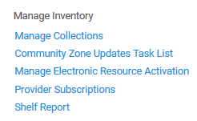
Accessing the "Provider Subscriptions"
From the "Resources" menu "Manage Inventory" submenu access the "Provider Subscriptions" link.

Slide 8
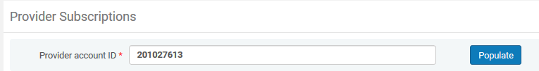
Accessing the "Provider Subscriptions"
Fill in your unique "Provider account ID" and click "Populate"

Slide 9
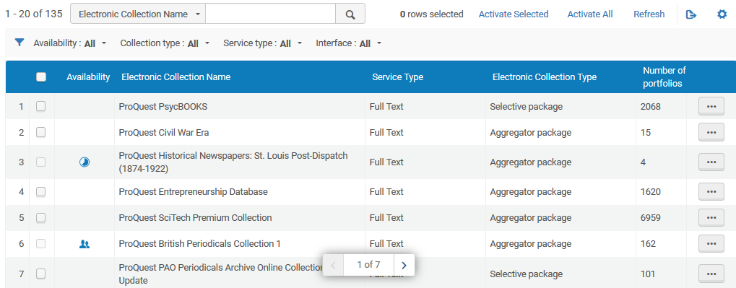
Accessing the "Provider Subscriptions"
The list is populated with those resources purchased by the institution

Slide 10
Using the "Provider Subscriptions"

Slide 11
Using the "Provider Subscriptions"
When "Availability" column is empty the resource has not been activated.
This collection was recently sent for activation and is currently in process
This collection had not been activated
This collection is already activated in the institution

Slide 12
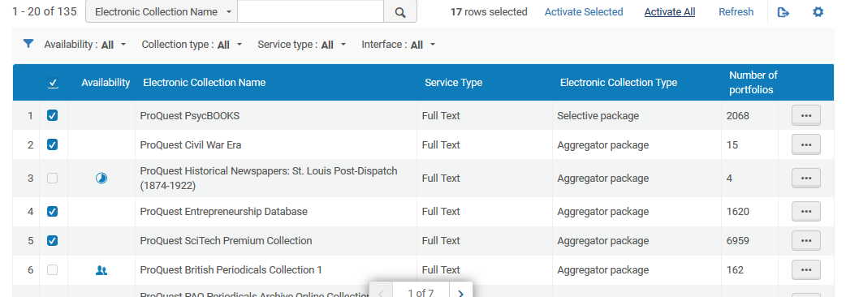
Using the "Provider Subscriptions"
User can "Select all" and "Activate all".

Slide 13
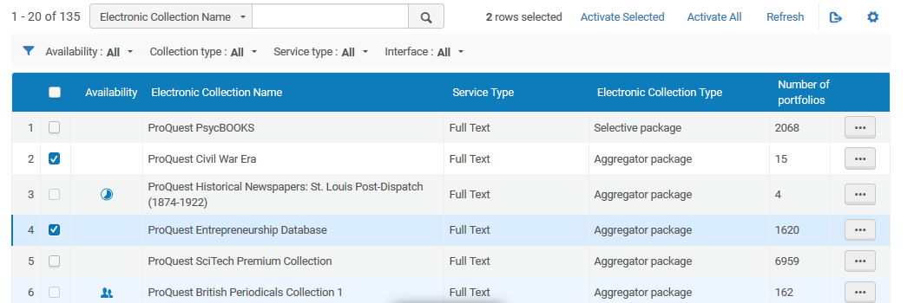
Using the "Provider Subscriptions"
User can select specific collections and "Activate selected".

Slide 14
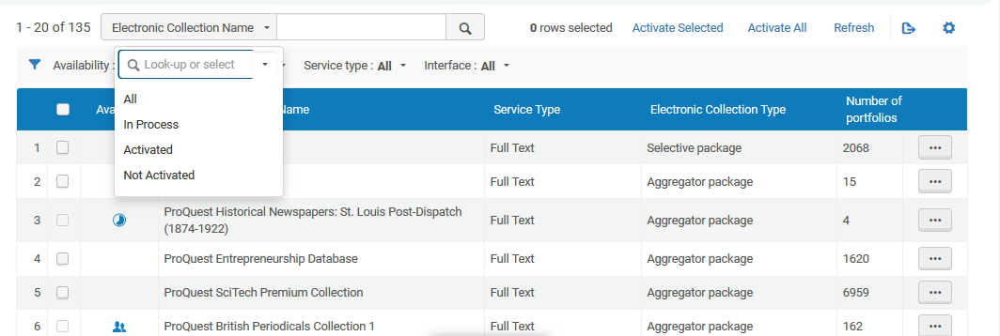
Using the "Provider Subscriptions"
User can filter by various parameters

Slide 15
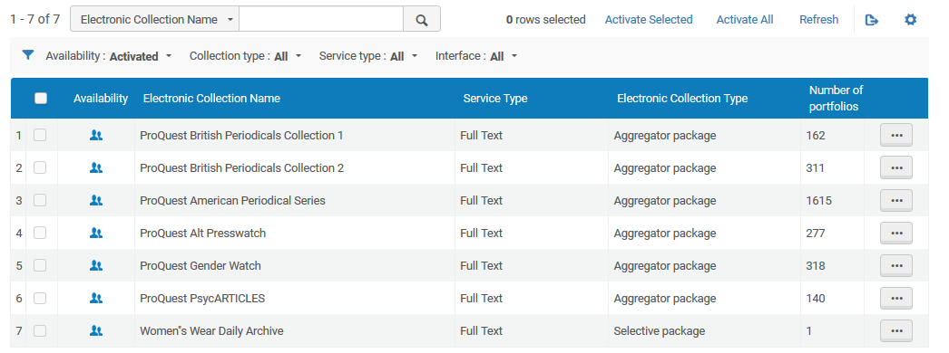
Using the "Provider Subscriptions"
Here for example we have filtered by only those which have been activated

Slide 16
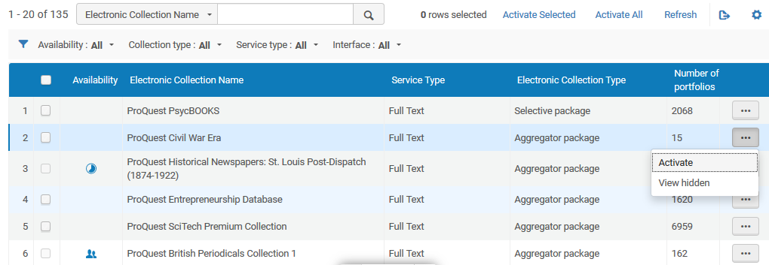
Using the "Provider Subscriptions"
Collections can also be activated one at a time on the line level

Slide 17
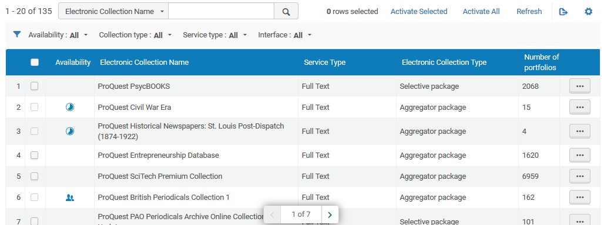
Using the "Provider Subscriptions"
The list can also be refreshed to obtain current status
Before refresh

Slide 18
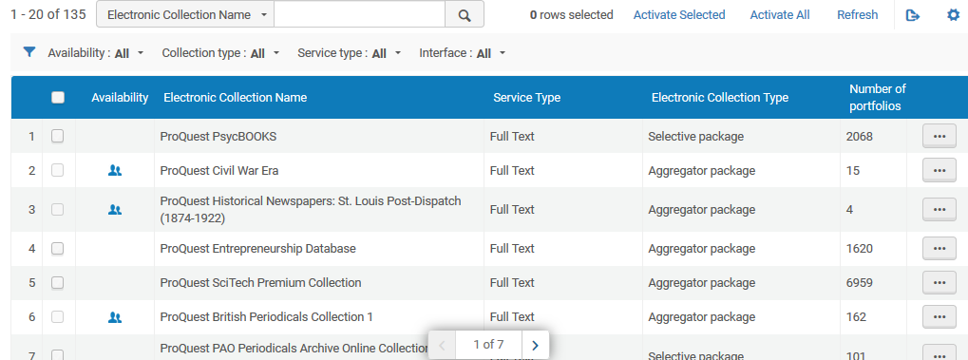
Using the "Provider Subscriptions"
After refreshing user sees a "refreshed" status
After refresh

Slide 19
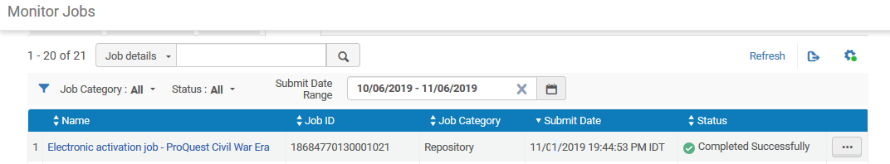
Using the "Provider Subscriptions"
When one or more collections are activated from the "Provider Subscriptions" the activation is done via a background job, enabling the user to continue working in the list.

Slide 20
Yoel.Kortick@exlibrisgroup.com

